Slide 1



UTA EE Labs
Controlling your Arduino with Bluetooth
IEEE 802.15. 4

Slide 2
PowerPoint and Code
Github.com/EELabMan
Go To Repositories and find Arduino 9 Bluetooth

Slide 3
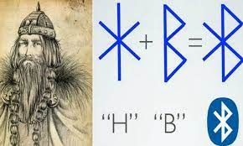
Why the Name Bluetooth
King Harald “Bluetooth” Gormsson was viewed as a great uniter.
He ate lots, and lots of blueberries.
Bluetooth tech seeks to “unite” devices.
Bluetooth symbol is his initials in Nordic Runes.

Slide 4
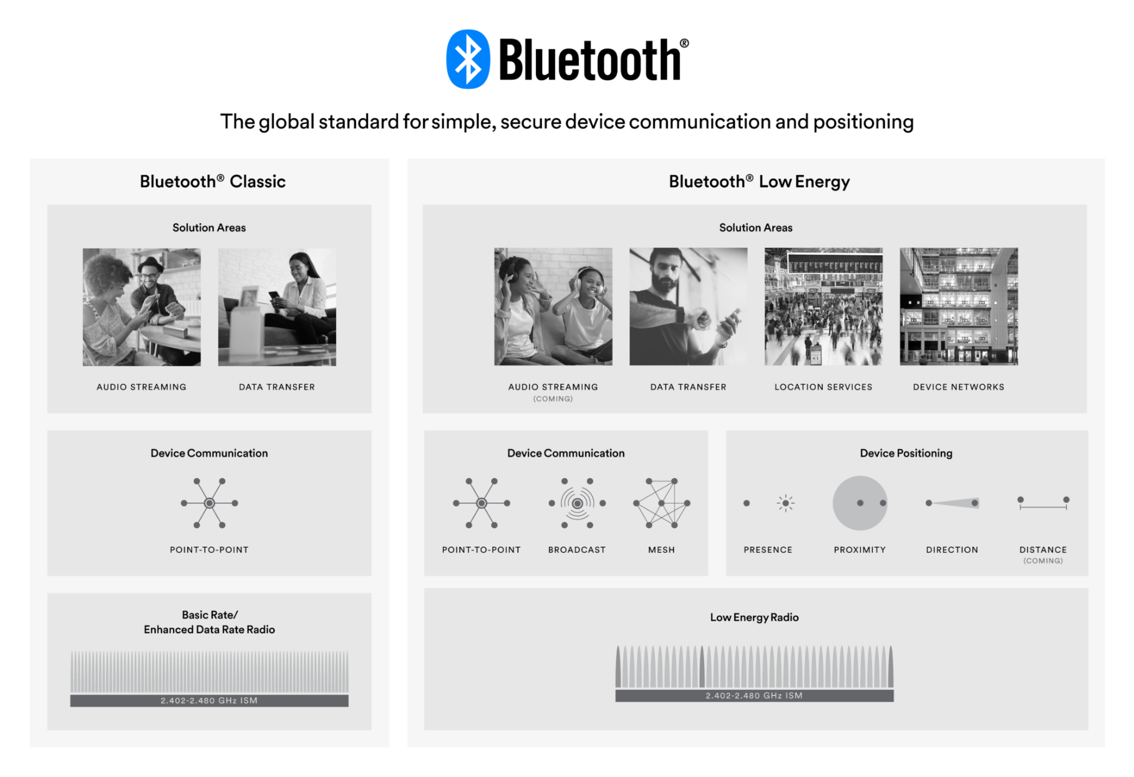
Differences in Bluetooth classic, 4.2 and 5.0

Slide 5
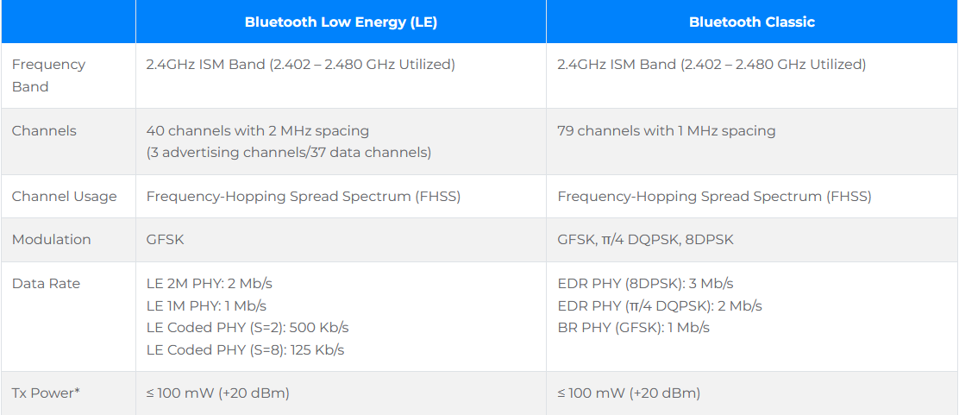
BLE Versus Bluetooth Classic
Come to the RF workshop if this is confusing

Slide 6
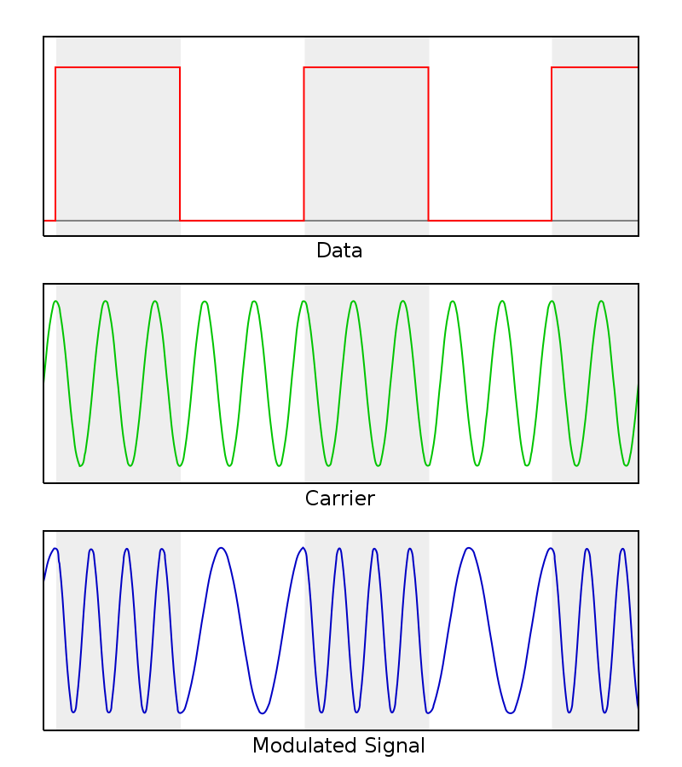
Modulation: Frequency Shift keying
Data
Carrier Frequency
Modulated Carrier

Slide 7
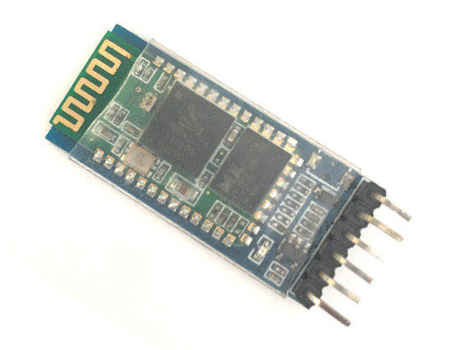
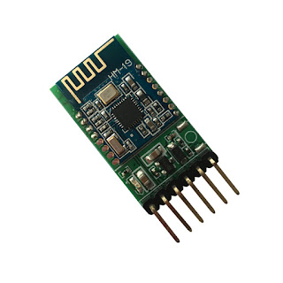
HC-05 & HM-19 Bluetooth module
HC-05
Uses Bluetooth 3.0
iPhone does not support BT 3.0
HM-19
Uses Bluetooth 5 and 4.2
Most modern phones support Bluetooth 4.0 and higher

Slide 8
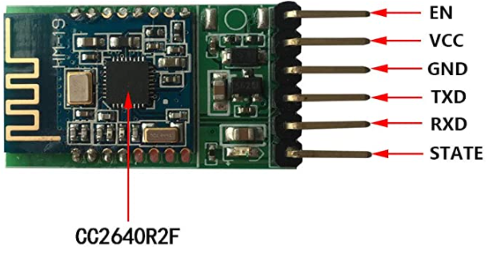
HM-19 Pinout
TI CC2640R2F Bluetooth Chip
Antenna is a trace on the PCB
3.3V Logic to RX Pin. Must use a voltage divider to lower 5V logic from Arduino.

Slide 9
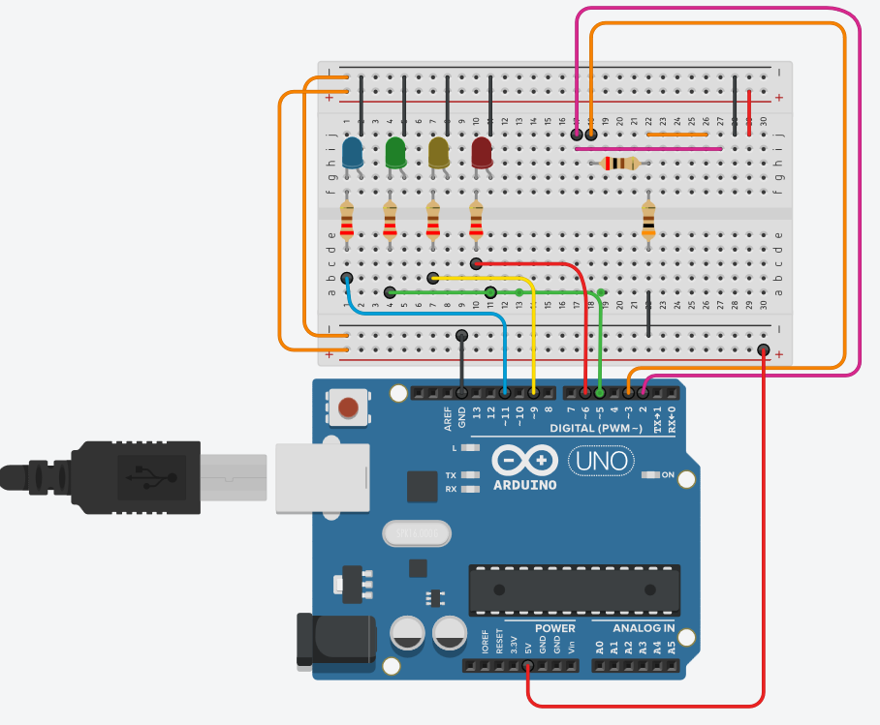
Let’s Create
Cathode is on the right
Notice the 200 and 300 Ω resistors make a voltage divider because the Arduino has 5V logic but the HM-19 takes 3.3V logic

Slide 10
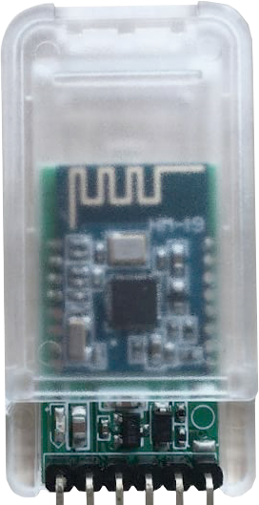
Let’s Create
Insert the HM-19 Module
Turn on the Oscilloscope and measure the RX on channel 1 and the TX on channel 2 so you can see if both the TX and RX are working.

Slide 11
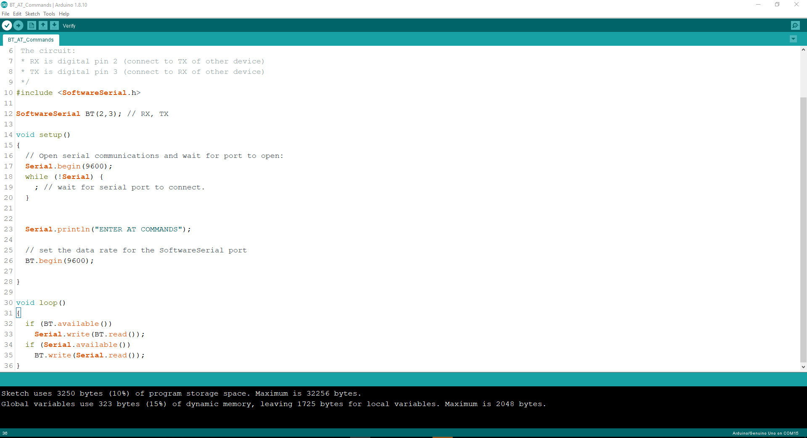
Let’s Code
Download BT_AT_Commands.ino from the UTA EE Lab Git hub page:
Upload this to the Arduino

Slide 12
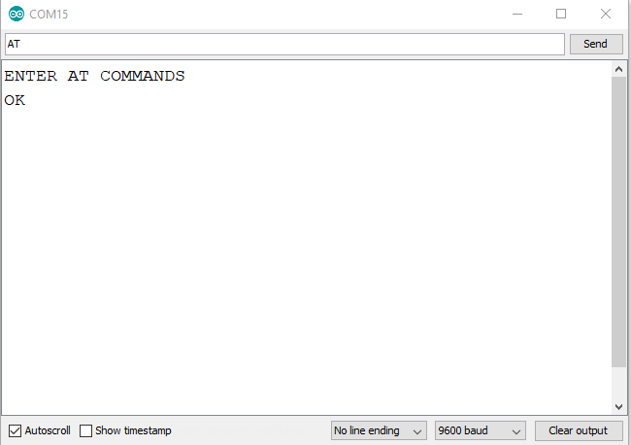
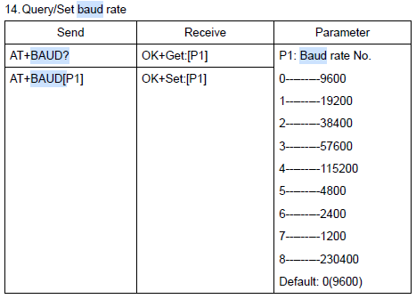
AT COMMANDS for HM-19
Open the serial monitor and enter the following AT Commands
AT : Check the connection. Should return OK AT+NAME? : See default name AT+ADDR? : Returned the device MAC Address AT+VERS? : See firmware version AT+BAUD? : See baudrate Many more on the datasheet.
You might need to change the following to get it to work
No line ending just sends what you put. New line sends an ASCII new line code after what you put Carriage return puts an ASCII carriage return character after what you put.
NL + CR puts both a carriage return and a new line character after what you put.

Slide 13
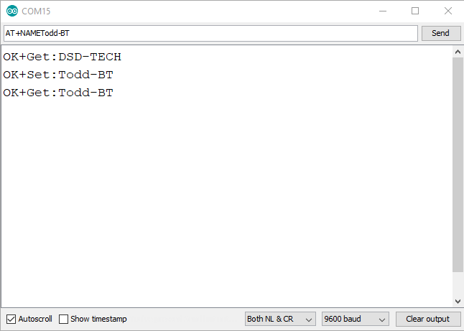
Set a new Name for the HC-19
Type AT+NAMEXXX - XXX is any short name you want.
Should return OK
Type AT+NAME? to confirm new name.

Slide 14
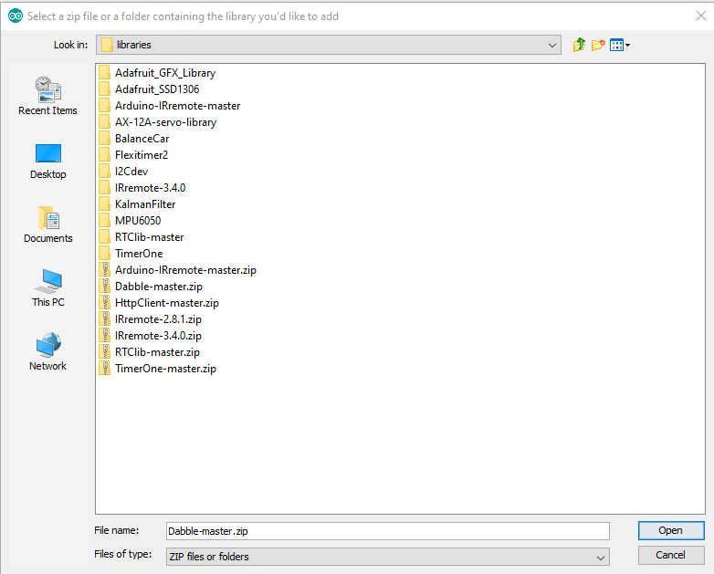
Add the Dabble Library to Arduino
Download the Dabble Arduino Library ZIP file from our GitHub page.
Place it in the Documents\Arduino\libraries folder. Do not unzip the zip file.
In the Arduino IDE go to Sketch -> Included Library -> Add ZIP Library.
Select the Dabble-master.zip file from the Documents\Arduino\libraries folder.

Slide 15
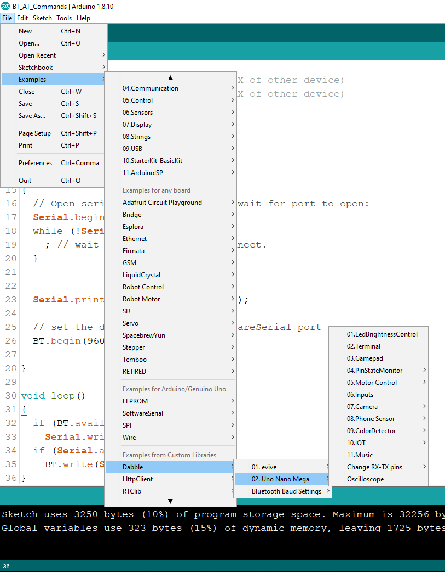
Open the Sketch
File -> Examples -> Dabble -> 02.Uno Nano Mega
Select 01.LedBrightnessControl
Upload to your UNO.

Slide 16
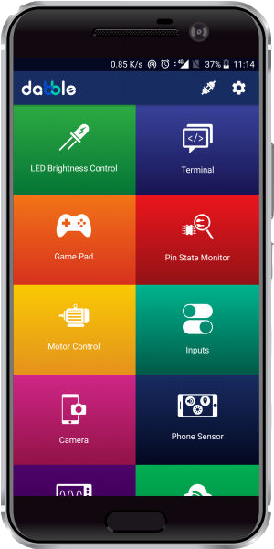


Install Dabble on your smart phone
Dabble is available for the Android user functioning on Android version 5.0.0 and above.
It is compatible with iPhone, iPad, and iPad touch and requires iOS 12.2 and above
Might need to install from the web site.

Slide 17
Open Dabble and connect
Open dabble and select the connection icon
Find your BT device and select

Slide 18
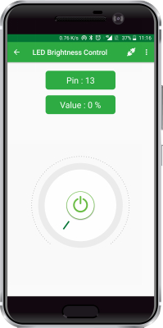
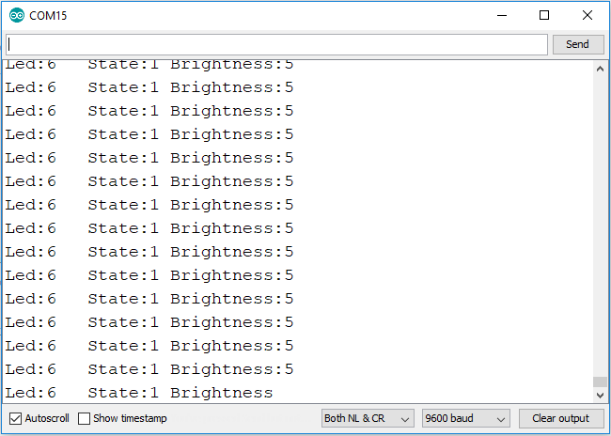
Open the LED Brightness Control
Open the serial monitor in the Arduino IDE
Select pins 5, 6, 9 and 11 on the Dabble app to control the LED’s.

Slide 19
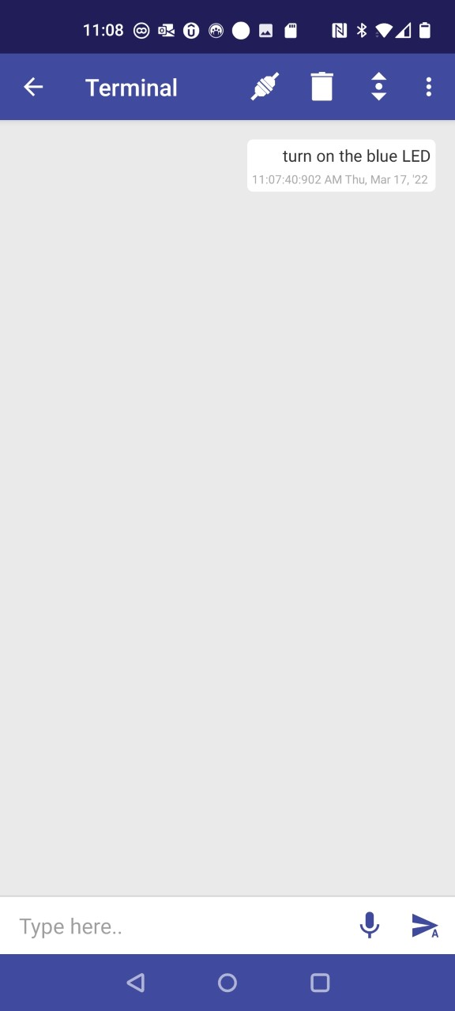
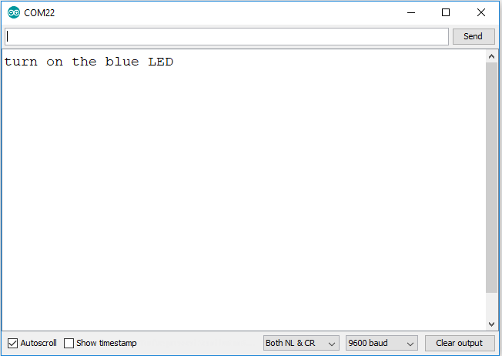
Open the Sketch
Disconnect from Dabble on your phone first.
Download from GitHub Terminal_Voice.ino
Upload to your UNO.
Open Dabble and connect to BT.
Open terminal
Open the serial Monitor in the Arduino IDE
Press the microphone on Dabble and say “Turn on the blue LED”
Depending on your voice assistant, you may need to change the Arduino code.
Try “all on” and “all off”
Type a message in the Arduino Serial Monitor to send to Dabble

Slide 20

Dabble GamePad
Download Gamepad_LED.ino from GitHub and upload it to your Arduino
Open Dabble and connect again.
Examine the code while pressing the buttons.
Check the BAUD Rate!

Slide 21
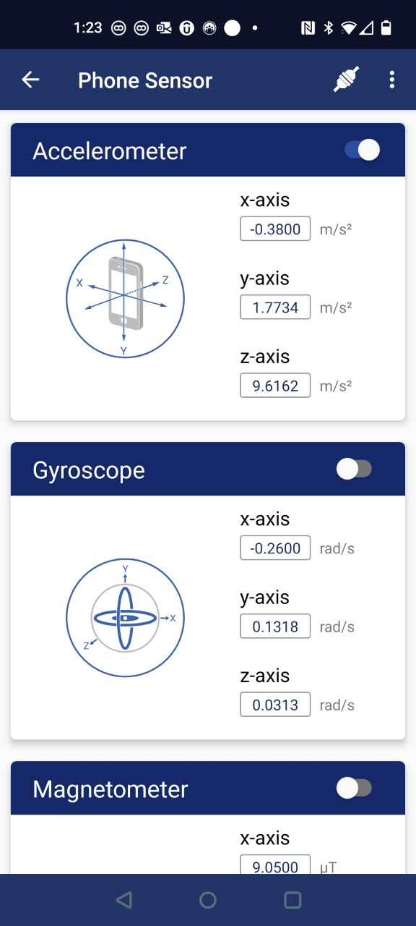
Phone Sensors
A lot of neat things your phone can do. We’ll play with the accelerometer.
Download Accelerometer_LED.ino from GitHub.
Upload to the Arduino and open the serial monitor.
Open Dabble and select Phone Sensors.
Switch the Accelerometer on and rotate your phone.
Check the BAUD Rate on the serial monitor.
Try editing the code to light up the LEDS in order as you twist your phone

Slide 22
Stay tuned
Arduino 10 will cover Hardware and Timer Interrupts
We’ll make a sound machine

